Slide 1

Apache Kafka
Apache Kafka is a fast, scalable, fault-tolerant messaging system which enables communication between producers and consumers using message-based topics.
Also, it allows a large number of permanent or ad-hoc consumers. One of the best features of Kafka is, it is highly available and resilient to node failures and supports automatic recovery. This feature makes Apache Kafka ideal for communication and integration between components of large-scale data systems in real-world data systems.
What is Kafka?

Slide 2
Apache Kafka
What is a Messaging System?
The main task of managing system is to transfer data from one application to another so that the applications can mainly work on data without worrying about sharing it.
Distributed messaging is based on the reliable message queuing process. Messages are queued non-synchronously between the messaging system and client applications.
There are two types of messaging patterns available:
Point to point messaging system
Publish-subscribe messaging system
Application 1
Data
Messaging System
Data
Application 2

Slide 3
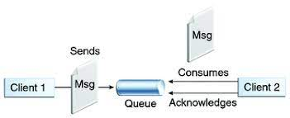
Apache Kafka
Point to Point Messaging System
In this messaging system, messages continue to remain in a queue. More than one consumer can consume the messages in the queue but only one consumer can consume a particular message.
After the consumer reads the message in the queue, the message disappears from that queue.
Queue
Sender
Receiver

Slide 4
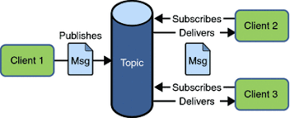
Apache Kafka
Publish-Subscribe Messaging System
In this messaging system, messages continue to remain in a Topic. Contrary to Point to point messaging system, consumers can take more than one topic and consume every message in that topic.
Message producers are known as publishers and Kafka consumers are known as subscribers.
Subscriber1
Queue
Publisher
Subscriber2

Slide 5
Apache Kafka
History of Apache Kafka
Previously, LinkedIn was facing the issue of low latency ingestion of huge amount of data from the website into a lambda architecture which could be able to process real-time events.
As a solution, Apache Kafka was developed in the year 2010, since none of the solutions was available to deal with this drawback, before.
However, there were technologies available for batch processing, but the deployment details of those technologies were shared with the downstream users. Hence, while it comes to Real-time Processing, those technologies were not enough suitable. Then, in the year 2011 Kafka was made public.

Slide 6
Apache Kafka
Need of Apache Kafka Cluster
As we all know, there is an enormous volume of data used in Big Data. For data, there are two main challenges.
One is how to collect and manage a large volume of data
the other one is the analysis of the collected data.
For dealing with such challenges, you need to have a messaging system.
There are many benefits of Apache Kafka that justifies the usage of Apache Kafka:
Tracking web activities by storing/sending the events for real-time processes.
Alerting and reporting the operational metrics.
Transforming data into the standard format.
Continuous processing of streaming data to the topics.
Therefore, this technology is giving a tough competition to some of the most popular applications like ActiveMQ, RabbitMQ, AWS, etc. because of its wide use.

Slide 7
Apache Kafka
Kafka Architecture – Four Core API’s
Producers
Connectors
App
App
App
Stream Processors
DB
App
Kafka Cluster
App
DB
App
App
App
Consumers

Slide 8
Apache Kafka
Kafka Architecture – Four Core API’s
Kafka Producer API: This Kafka Producer API permits an application to publish a stream of records to one or more Kafka topics.
Kafka Consumer API: The Consumer API permits an application to take one or more topics and process the continous flow of records produced to them.
Kafka Streams API: The Streams API permits an application to behave as a stream processor, consuming an input stream from one or more topics and generating an output stream to one or more output topics, efficiently modifying the input streams to output streams.
Kafka Connector API: The Connector API permits creating and running reusable producers or consumers that enables connection between Kafka topics and existing applications or data systems.

Slide 9
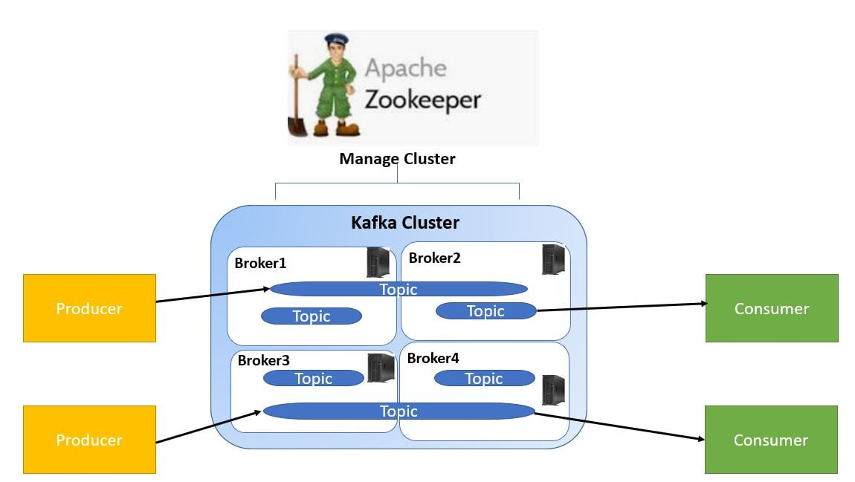
Apache Kafka
Kafka Components

Slide 10
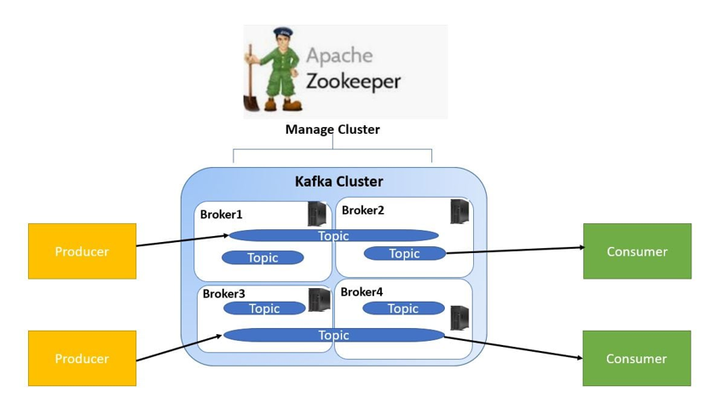

Apache Kafka
Kafka Components
1. Kafka Topic
A bunch of messages that belong to a particular category is known as a Topic. Data stores in topics.
In addition, we can replicate and partition Topics. Here, replicate refers to copies and partition refers
to the division.
Also, visualize them as logs wherein, Kafka stores messages.
However, this ability to replicate and partitioning topics is one of the factors that enable Kafka’s fault tolerance and scalability.
Topic
Partition 0
1 | 2 | 3 | 4 | 5 | 6 | 7
Partition 1
1 | 2 | 3 | 4 | 5 | 6
Writes
Partition 2
1 | 2 | 3 | 4 | 5 | 6 | 7

Slide 11
Apache Kafka
Kafka Components
2. Kafka Producer
The producers publish the messages on one or more Kafka topics.
3. Kafka Consumer
Consumers take one or more topics and consume messages that are already published through extracting data from the brokers.
4. Kafka Broker
These are basically systems which maintain the published data. A single broker can have zero or more partitions per topic
5. Kafka Zookeeper
With the help of zookeeper, Kafka provides the brokers with metadata regarding the processes running in the system and grants health checking and broker leadership election.

Slide 12
Apache Kafka
Log Anatomy
We view log as the partitions. Basically, a data source writes messages to the log. One of the advantages is, at any time one or more consumers can read from the log they select. Here, the below diagram shows a log is being written by the data source and read by consumers at different offsets.
Data Source
Writes
Log
Order 1 | Order 2 | Order 3 | Order 4 | Order 5 | Order 6 | Order 7
Offset 1
Offset 2
Offset 3
Offset 4
Offset 5
Offset 6
Offset 7
Read
Read
Consumer
Consumer

Slide 13
Apache Kafka
Data Log
By Kafka, messages are retained for a considerable amount of time. Also, consumers can read as per their convenience. However, if Kafka is configured to keep messages for 24 hours and a consumer is down for greater than 24 hours, the consumer will lose messages.
And, messages can be read from last known offset, if the downtime on part of the consumer is just 60 minutes. Kafka doesn’t keep a track on what consumers are reading from a topic.

Slide 14
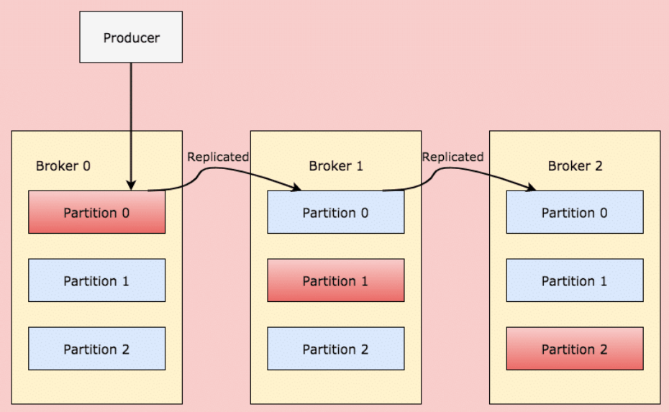

Partition in Kafka
Apache Kafka
When a client writes something to a topic at a position for which Partition in Broker 0 is the leader, this data is then replicated across the brokers/nodes so that message remains safe
There are few partitions in every Kafka broker. Each partition can be either a leader or a replica of a topic. In addition, along with updating of replicas with new data, Leader is responsible for all writes and reads to a topic. The replica takes over as the new leader if somehow the leader fails.

Slide 15
Apache Kafka
Kafka Use Cases
Messaging
Kafka is the best substitute for traditional message brokers. We can say Kafka has better throughput, replication, fault-tolerance and built-in partitioning which makes it a better solution for large-scale message processing applications.
Metrics
Kafka is mostly utilized for operational monitoring data. It includes aggregating statistics from distributed applications to generate centralized feeds of operational data.
Event Sourcing
Kafka is a great backend for applications of event sourcing since it supports very large stored log data.

